Slide 1
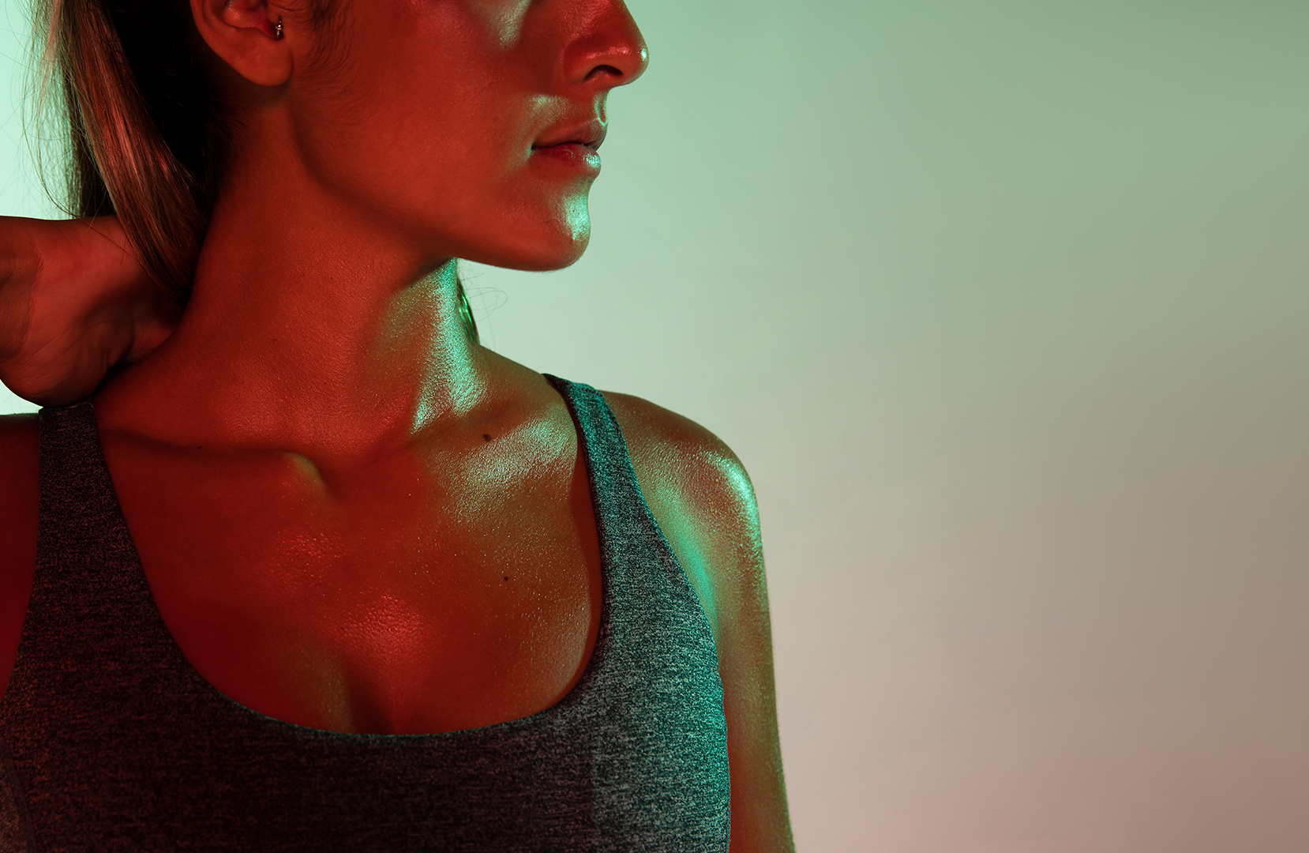
Intelligent
Gym Trainer
Supporting Pose Correction using YoloV4 and PoseNET

Slide 2
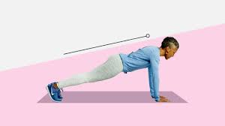
PROBLEM STATEMENT
Closure of gym for indefinite period
Beginners need a trainer during initial phase of exercising
Not everyone can cope up with the rigid timing of physical gym.
Many fitness app exists but not many focus on pose correction.

Slide 3
ABSTRACT
The most important thing that matters while exercising is safety, there are many injuries possible if one doesn’t take the necessary precautions.
To prevent such injuries one must focus on the posture and form while performing the respective exercises.
We will use PoseNet to help correct the exercise form and provide an inbuilt rep counter.

Slide 4
Ideation
REAL TIME VIDEO INPUT
PLOT BODY COORDINATES
CALCULATE ANGLES
Take video input through default or external camera.
Map the entire body,by providing x,y,z coordinate to each joint.
Using the coordinates and simple geometry, calculate the angles.

Slide 5
Equipment Classification
Devised using literature survey
Out of Image classification, detection and recognition we choose detection model, image classification cannot identify several classes of equipment independent of each other
Major Object detection models are: Region Proposals, YOLO, Single Shot Detector(SSD)
Since equipments are fairly distinct weightage of accuracy is not as much as of speed
SSD gives equal weightage to both speed and accuracy whereas YOLO is faster.
YOLO is not able to detect very small images, comparing yolov5 and yolov4, yolov4 can detect smaller size images better also not much difference in speed.

Slide 6
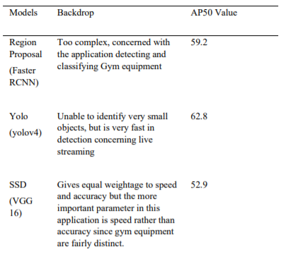

Slide 7
YoloV4
YOLO (You Only Look Once) is a single-stage detector algorithm that uses the concept of convolutional neural networks to detect objects
YOLO will not only be able to determine the classes of the objects in the image, but also where the given objects are located in the image.
It creates a bounding box around the object after correctly identifying its respective class.
YOLO can not only detect objects in an image stored in your local file but also detect objects in real time using the camera input

Slide 8
We will be using YOLOV4 for the purpose of training as well as object detection.
A dataset is first created containing required number of images of each equipment class. These images are then annotated to produce their annotation files that gives info about the co-ordinates of the bounding boxes
A configuration file is also created that takes in info about the number of classes, max iterations, number of CNN layers, filters applied and so on.
This dataset is then trained using YOLOV4 with the help of the above mentioned cfg file to produce a weights file which is updated every iteration.

Slide 9
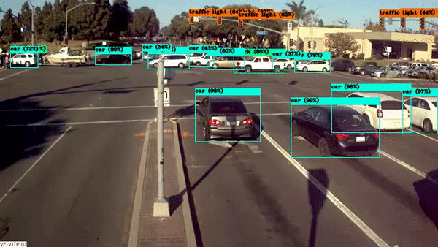

Once the training is completed, we check the average precision for prediction of each class as well as our final average accuracy of the model.
Once the model is trained and weight file is created, the model is ready to be used, for both real time camera input as well as detections on images stored in local device or drive.

Slide 10


Dataset
A hand made dataset of equipments find at home
Dataset created using Open Image Dataset(OID) and web scraping
Manual annotation of web scraping using roboflow.ai

Slide 11
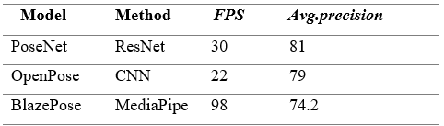
Why PoseNet?
Devised using literature survey
According to survey most Pose correctors use either PoseNet or OpenPose
Efficiency of PoseNet and OpenPose are comparable
Openpose is more efficient but also it works on GPU which cannot always be applied for a web app like ours
We are using a live feed so
incase of no GPU it will affect
its performance.

Slide 12
Plot Body Coordinate
In order to provide the Human Body Coordinates we use a library called MEDIAPIPE
MediaPipe is a graph-based framework for building multimodal (video, audio, and sensor) applied machine learning pipelines.
Tracks human body movements and assigns 3-D coordinates to different joints.
Coordinates are stored in the form of an array.
In an image these coordinates are static(are constant) while in a video they are dynamic( keeps changing).

Slide 13
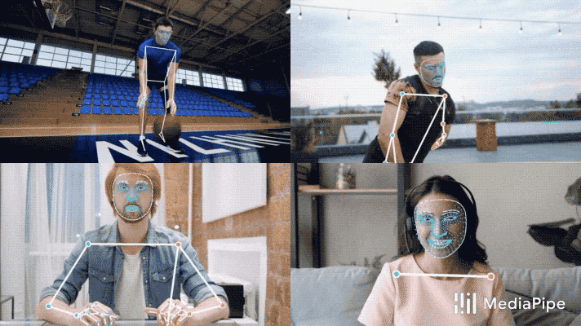
PLOT BODY COORDINATES

Slide 14
Calculate Angles
With the help of mediapipe we will get an array of coordinates. We can use simple coordinate geometry to calculate the angles at different coordinates.
For a particular exercise, we keep measuring these angles. If we detect a weird angle (improper posture) we generate a warning .
As angles vary we keep incrementing the rep counter.

Slide 15
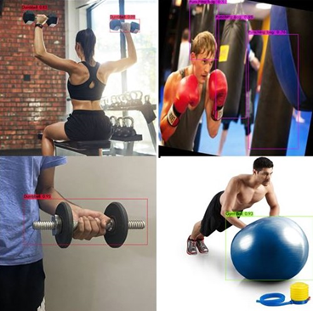
Results
Detection Algorithm for detecting common Gym Equipments found at home like dumbbell, Gym Ball using yolov4

Slide 16
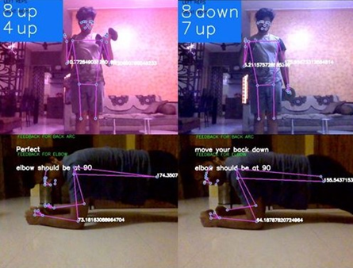
Results
Proper comments on angle to correct posture specific to joints using PoseNet.
Here in particularly for plank it corrects elbow and back angle

Slide 17
PROS AND CONS
Pros:
Workouts possible at home.
Better exercise results
Suitable for all age groups and people of all competency and experience in gyming.
Redirects user to tutorials if in doubt.
Cons:
No one-to-one personal trainer
Not all exercises covered in this prototype.
For beginners it would be difficult to achieve perfect angle of posture but the system can deny them from moving forward with other exercise

Slide 18
References
Chen, Steven & Yang, Richard. Pose Trainer: Correcting Exercise Posture using Pose Estimation.
Nagarkoti, Amit & Teotia, Revant & Mahale, Amith & Das, Pankaj. (2019). Realtime Indoor Workout Analysis Using Machine Learning & Computer Vision. Conference proceedings: ... Annual International Conference of the IEEE Engineering in Medicine and Biology Society. IEEE Engineering in Medicine and Biology Society. Conference. 2019. 1440-1443. 10.1109/EMBC.2019.8856547.
BlazePose: On-device Real-time Body Pose tracking
Valentin Bazarevsky, Ivan Grishchenko, Karthik Raveendran, Tyler Zhu, Fan Zhang, Matthias Grundmann
Pavement Distress Detection and Segmentation using YOLOv4 and DeepLabv3 on Pavements by James-Andrew Sarmiento
Automatic Feedback For Physiotherapy Exercises Based On PoseNet by Hussein Ayman Hassan

Slide 19
THANK YOU

Slide 20
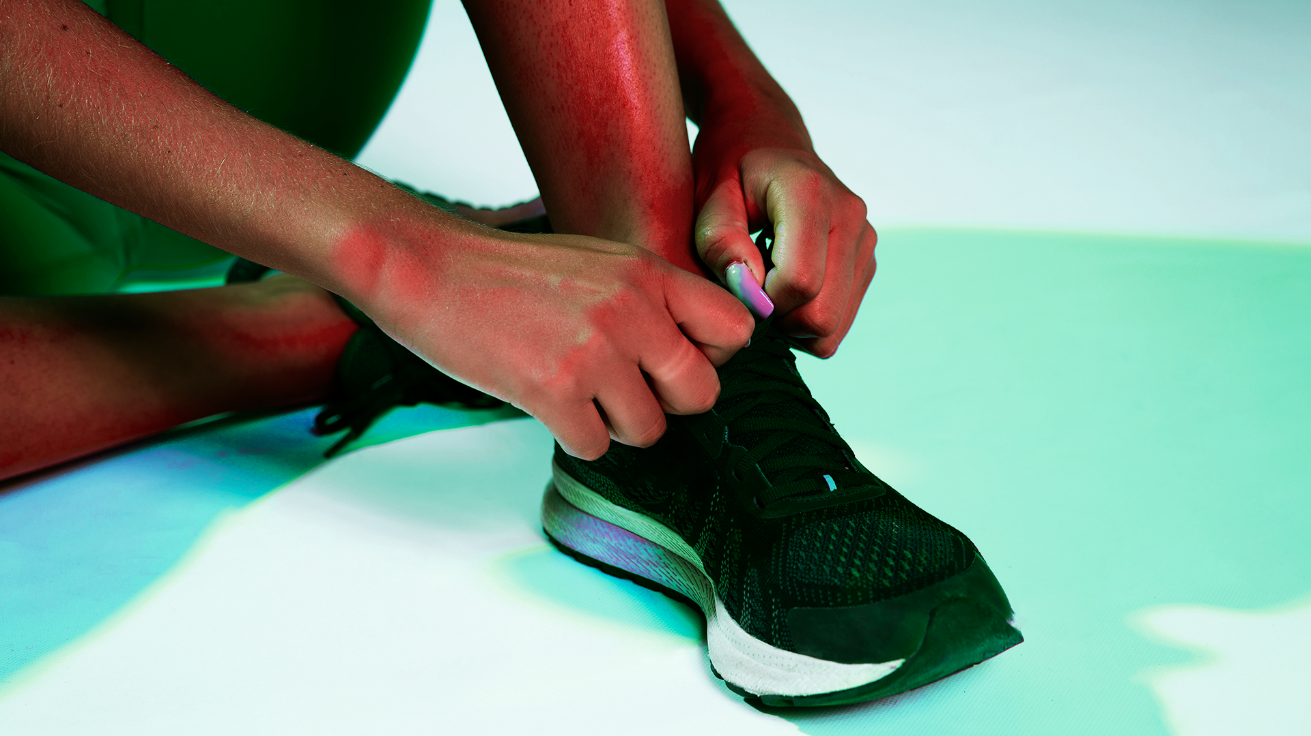
LITERATURE
SURVEY

Slide 21
TITLE​ | ALGORITHM | IMPLEMENTATION | RESEARCH GAP
Pose Trainer: Correcting Exercise Posture using Pose Estimation | OpenPose | Takes a video clip as input and identifies keyframes. Then in 2 stages pose estimation (classification of pose) and result are obtained (message as to posture was correct or not) | OpenPose works on just 16 joints which misses out on posture for exercise Computationally heavy and slow Not done in real time but as a recorded exercise clip.
Realtime Indoor Workout Analysis Using Machine Learning & Computer Vision | Multi-Person 2D Pose Estimation using Part Affinity Fields | Pre fed keyframes are extracted from server and actual keyframe of user marked using OpenPose.The result is in the form of error percentage from the distance actual to pre fed data. | A 10 second video takes almost 30 second to process and show result Error percentage result is not helpful in training or helping user.

Slide 22
TITLE​ | ALGORITHM | INFERENCE | RESEARCH GAP
Pavement Distress Detection and Segmentation using YOLOv4 and DeepLabv3 on Pavements by James-Andrew Sarmiento in 2021 | YOLOV4 | Really useful to detect uneven roads as well as deep cracks developed due to wear and tear through the years | Dataset used consisted of only 242 test images as such the the accuracy was not enough. Roads can have very varied types of deformities which can be difficult to classify as one.
Automatic Feedback For Physiotherapy Exercises Based On PoseNet by Hussein Ayman Hassan in 2020 | PoseNet | It can help physiotherapy patients of varying age groups with their exercises by correctly guiding them through the exercises and prevents them from getting hurt | It covers only a total of eight exercises and cannot detect keypoints of both the left and right sides at the same time. Suggests corrections and feedbacks after around a minute of the execution of the exercise rather than real time.

Slide 23
TITLE​ | ALGORITHM | INFERENCE | RESEARCH GAP
BlazePose: On-device Real-time Body Pose tracking | Linear Regression | Is used in mediapipe framework. It is a lightweight body pose estimation neural network that uses both heatmaps and regression to keypoint coordinates. Outperforms OpenPose for fitness/gym uses and is 25-75 times faster in mobile CPUs,with higher fps. | Face of the person needs to be visible to the webcam for body alignment purposes. OpenPose outperforms it in uses other than gym/fitness .

Slide 24
AUTHORS
Pratishtha Gaur
Aryan Patel
Dr. Sridhar Raj S

Slide 25
01
02
03
AGENDA
04
05
06
DEMO DESIGN
METHODOLOGY
PROBLEM STATEMENT
ALGORITHMS
PROS AND CONS
LITERATURE SURVEY

Slide 26
Tentative Demo Design
We plan to build mainly 2 modules which can later on be extended
Equipment classification and redirection to all the exercises related to the equipment. (for lesser known exercise like for gym ball)
In next module user can select the exercise they want to do and a virtual trainer will correct the pose and give proper advice based on that.
Extended modules like separate beginner and advance mode(different correction margins)
Notes:
Extension- 2 modes Beginner and Advanced- difference in error margin

Slide 27
ARCHITECTURE
DIAGRAM

Slide 28
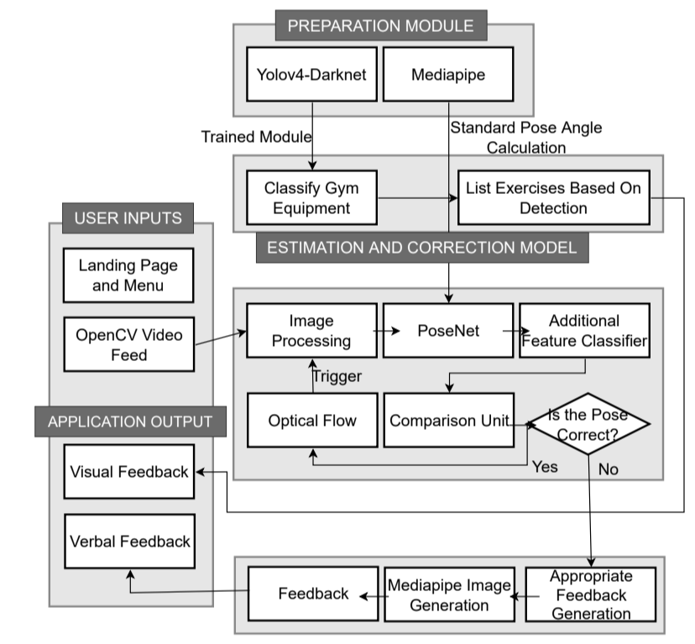

Slide 29
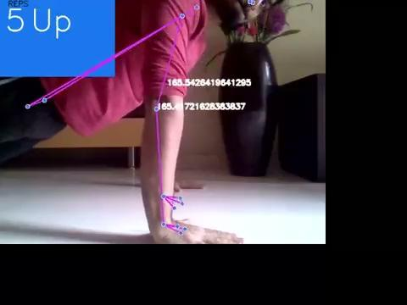
Results
Exercise Rep counter for pushups

